Slide 1
Week 3 Live Session
Wendy Christensen, Ph.D.
COMP 4442
Spring 2021

Slide 2
Agenda
Course logistics
Problem Set 2 questions
Regression models
Regression diagnostics
Problem Set 3 overview

Slide 3
Upcoming deadlines (all 11:59 p.m. MDT)
Week 2 Participation: Due Sunday, 4/11 (past due, please get these in)
Problem Set 2: Due this Friday, 4/16
Week 3 Participation: Due this Sunday, 4/18
Assigned today: Problem Set 3, due 4/23 (next Friday)

Slide 4
Quick notes about assignments
For problem sets, please be sure to submit your knitted PDF or Word documents.
For all assignments, please include your name in the file name of the document/s being submitted (e.g., Wendy_Christensen_ProblemSet1.pdf)
If you need to re-upload anything, please contact me so I can re-open submission for you. When you re-upload the file, change the filename to reflect that it is a resubmission (e.g., Wendy_Christensen_ProblemSet1_reupload.pdf)
If you want to upload a missing assignment, please contact me so I can unpublish your grade. This will allow you to submit your assignment.

Slide 5
Problem Set 2 questions?

Slide 6
Regression models

Slide 7
Data requirements of regression
Like ANOVA models, regression models require that the outcome is a continuous measure. We will learn about some models that loosen this requirement later…
Unlike ANOVA, regression models can use both categorical variables and continuous variables in the same model to predict the outcome.
Continuous variables can be entered into a regression model as they are. Categorical variables, however, must be converted into vectors. The most common choice for this is “dummy” coding, but other coding schemes exist.

Slide 8
Dummy coding primer
Say, for example, that you have a variable that indicates the type of area in which someone resides: city, suburban, or rural. Dummy coding represents these levels by creating new variables that use k-1 binary “vectors” (new variables) of 0 or 1 to represent k - 1 levels. 3 - 1 = 2, so this variable will need two dummy vectors.
The “reference category”, which has zeros in all vectors, is not included in the model. The lm() function will do the re-coding for you automatically for factor variables in your model.
Original value | D1 | D2
City (reference) | 0 | 0
Suburban | 1 | 0
Rural | 0 | 1

Slide 9

Simple linear regression
“Simple” linear regression refers to regression models that include just one predictor variable.
If the predictor variable is continuous, the regression equation will look like so:
Intercept coefficient
Predictor coefficient

Slide 10
Simple linear regression - coefficients
Y(i) = The actual value of the outcome variable for observation i.
X1(i) = The actual value of the predictor variable for observation i.
Beta(0) = The predicted value of the outcome when X1(i) equals zero.
Beta(1) = The predicted change in Y(i) for a one-unit change in X1(i)
Epsilon(i) = The deviation between the predicted outcome value for observation i and the actual value for observation i.

Slide 11
Multiple linear regression
“Multiple” regression refers to regression models with 2 or more predictor variables.
Regardless of the variable types of the predictors, the multiple regression equation will look like so:

Slide 12
Multiple linear regression - coefficients
These interpretations of the coefficients are the same as in simple regression EXCEPT:
Beta(p) = The predicted change in Y(i) for a one-unit change in X(pi) when the values of the other predictor variables are set to zero.
This is sometimes phrased as the effect of X(p) “holding all other predictors constant” or “after controlling for the effect of other predictors”.

Slide 13
Regression coefficients exercise!

Slide 14
Coefficients exercise - Question 1
The expected/predicted total of an order for a customer who uses no coupons is $25.20.
For each additional coupon a customer uses, the expected/predicted order total increases by $4.92.
A customer who uses three coupons has a predicted total sale of $39.96.

Slide 15
Coefficients exercise - Question 2
The expected/predicted total of an order for a customer who uses no coupons and has been in the loyalty program for zero years is $25.20.
For a customer who had belonged to the loyalty program for zero years (i.e., holding the effect of time in the loyalty program constant), the predicted total sale decreases by $2.19 for each coupon used.

Slide 16
Coefficients exercise - Question 2
For a customer who uses no coupons (i.e., holding the effect of number of coupons constant), the predicted total sale increases by $7.32 for each additional year the customer has been in the loyalty program.
The predicted total sale for a customer who used 2 coupons and has been in the loyalty program for 4 years is $50.10.

Slide 17
Coefficients exercise - Question 3
The expected/predicted total of an order for a customer who uses no coupons and paid in cash is $25.20.
For customers who pay in cash (i.e., holding payment type constant), the predicted total sale increases by $0.40 per coupon used.
For customers who use no coupons (i.e., holding coupon usage constant), the predicted total sale increases by $15.43 if the customer pays with a card.

Slide 18
Coefficients exercise - Question 3
The predicted total sale for a customer who used one coupon and paid cash is $25.60.

Slide 19
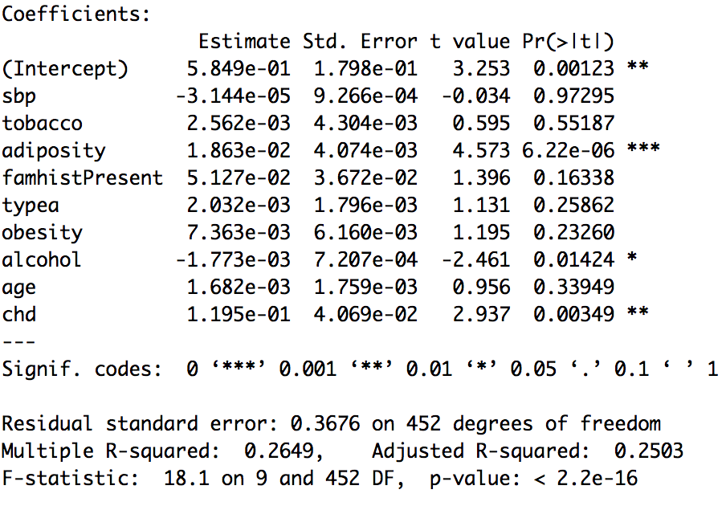
Multiple regression - output
This output is from the async material. The outcome was the log of the participant’s LDL cholesterol, and there were both categorical (e.g., chd, a diagnosis of coronary heart disease) and numeric (age, the participant’s age in years) predictors used.
The coefficient estimates, which we just practiced interpreting, are found in the Estimates column when displaying the results of the lm() function using the summary() function.

Slide 20
Tests of individual coefficients
Notice that each coefficient has a standard error, a t test statistic, and a p-value associated with it. That’s because it’s possible to conduct statistical null hypothesis tests for the individual predictors.
In the lm() function output in R, you read these as rows. All of the information for the tobacco variable is in this row.

Slide 21
Tests of individual coefficients
For each of these coefficients:
Null: The coefficient is equal to zero in the population
Alternative: The coefficient is not equal to zero in the population
You make your decision based on the p-value associated with each coefficient.

Slide 22
Regression diagnostics

Slide 23
Regression diagnostics
When discussing regression, “diagnostics” is a catch-all term referring to evaluating two aspects of a given regression model.
Are the assumptions of the regression model met?
Are there any data points that are “talking over” others?
We’ll start with assessing the assumptions of the regression model. Unlike with the types of assumption assessments we discussed in ANOVA, where we examined the raw data within group, regression assumptions are checked using information derived from the estimated model - that is, they cannot be fully assessed in advance.

Slide 24
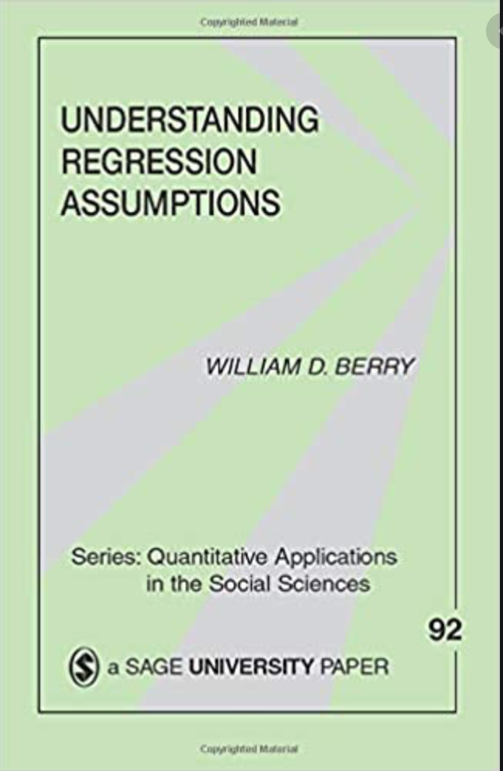
Regression assumptions
A mnemonic that I’ve heard that summarizes regression assumptions is LINE.
Linearity
Independence of errors
Normality of errors across values of X
Equality of error variance across values of X
For those who want a more thorough treatment:

Slide 25
Regression assumptions
Regression models are fitted in R using the lm() function (“linear model”). By default, the output of the lm() function will include four diagnostic plots
Plots for assumption checking: Residual plot, standardized residual plot, and QQ plot
Plot for assessing outliers: Residuals vs. leverage plot
Let’s review the assumption-checking plots, which are presented in the order they appear in the lm() function output:

Slide 26
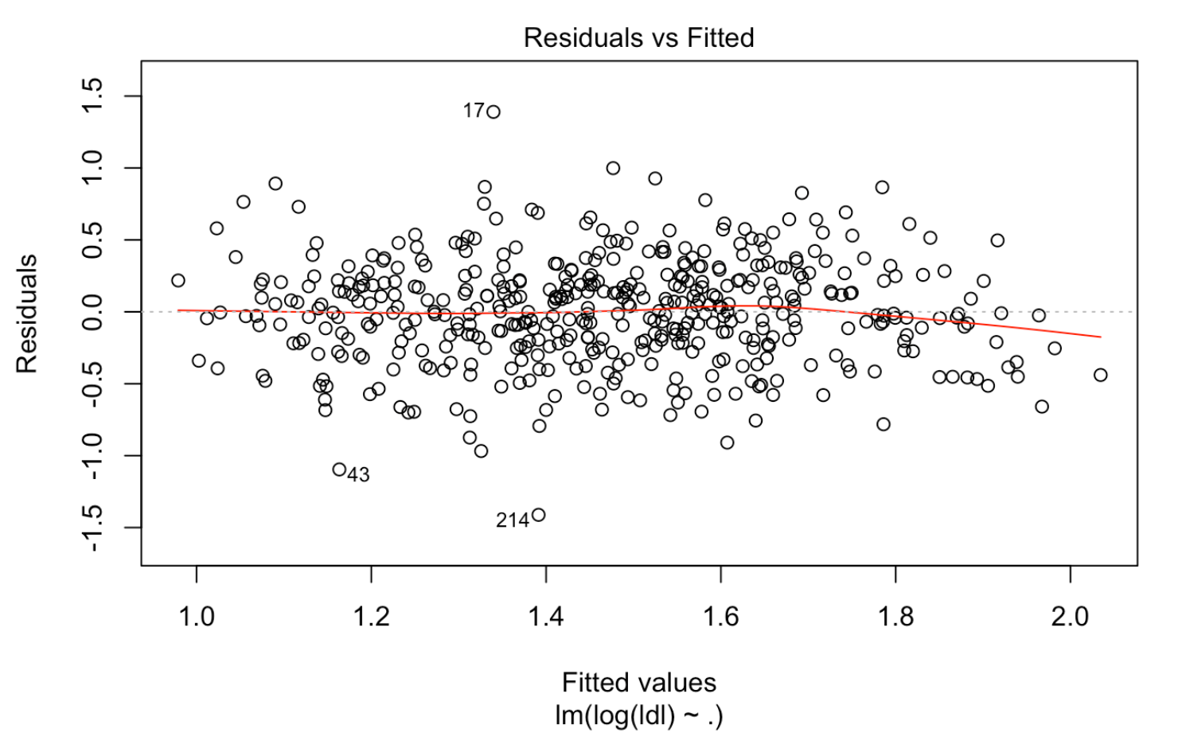
Diagnostic plots in lm() - residual plot
The first plot lm() gives you is a residual plot.
The red line is sometimes called a “Loess curve”. This helps assess linearity. If it’s mostly straight and “cuts” across the graph around 0 at the y-axis, the relationship between the predictors and Y is probably linear.
To assess equality of variance, look at the swarming of the points. The swarm should look mostly uniform. Bowties, bullhorns, and diamond shapes suggest heteroskedasticity.
Examples of these shapes

Slide 27
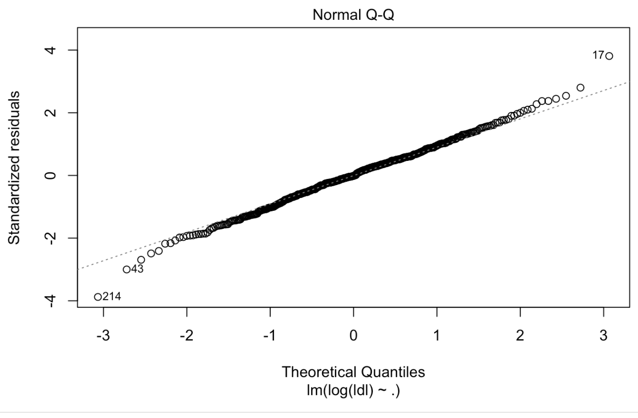
Diagnostic plots in lm() - QQ plot
The second plot lm() gives you is a Q-Q plot, which assesses the normality assumption. If the line of observations is reasonably diagonal, then the normality assumption is probably met.
If the assumption is violated, the coefficient estimates aren’t affected, but the coefficient hypothesis tests aren’t trustworthy because the standard errors of the t tests will be systematically too small (which results in Type 1 error rate inflation).

Slide 28
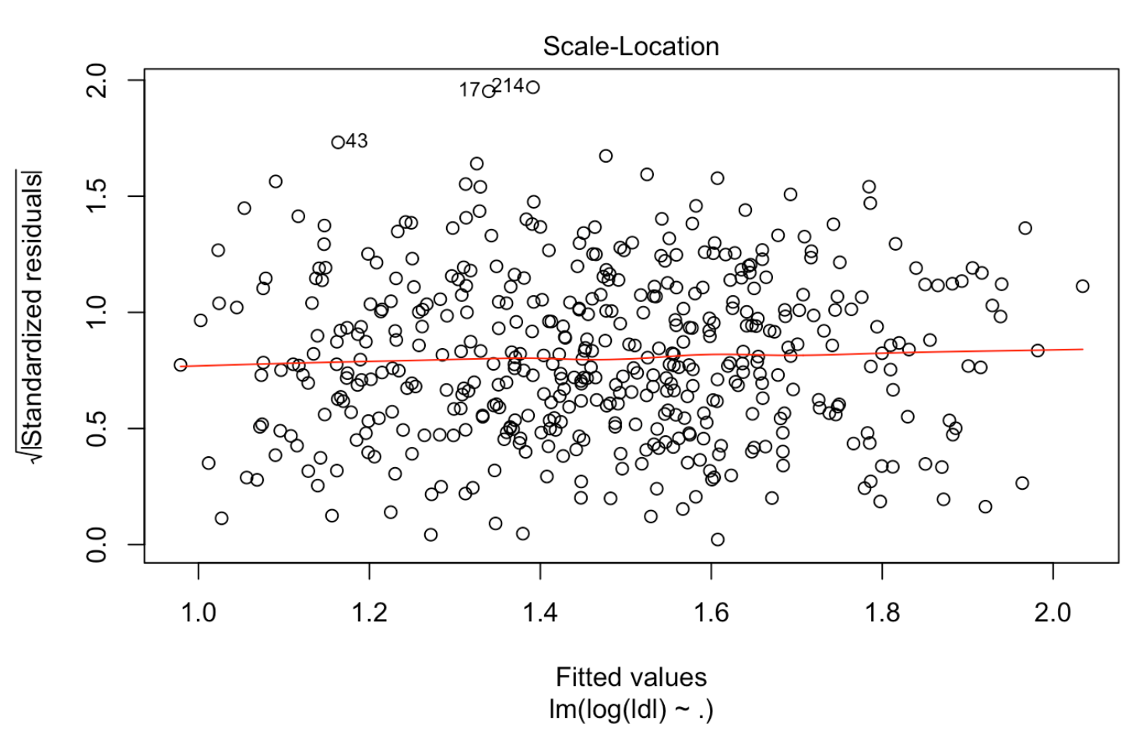
Diagnostic plots in lm() - standardized residual plot
This is the third plot that lm() shows you, and it’s very similar to the first. The only difference is that the residuals on the Y axis are standardized. The more extreme the residual, the higher up it will be.
It may be easier to assess heteroskedasticity using this plot.

Slide 29
Influential points
Along with assessing whether a model’s assumptions are met, it is also important to examine your data for observations that have undue influence on your model.
“Influential” points are those that would noticeably change the model’s parameter estimates if they were removed and the model were re-estimated.
Whether or not to remove influential points is a tricky decision. Some people prefer to keep any valid data points (i.e., only excluding observations that have mistakes) and others prefer to drop any influential points. In my opinion, the most important things are transparency and justification about decisions.

Slide 30
Influential points - outliers on Y given X
There isn’t one strict definition of the term “outlier”. Colloquially, it means any data point that stands out relative to the others. A more technical definition is a Y (outcome) value that is extreme given it’s X value.
Outliers on Y given X can be examined by looking at residuals for each observation. The greater the residual, the more likely that the point is influential (i.e., an outlier on Y given X). There are various transformations of the residuals (e.g., standardizing) that can be performed to make this easier to assess, but the general interpretation is the same.

Slide 31
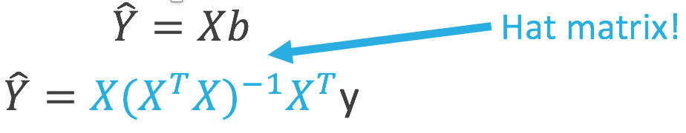
Influential points - outliers on X
The fourth plot provided by the lm() function displays a plot with residuals on the Y axis and leverage on the X axis. Much like a residual, each data point has a leverage value.
Leverage values = diagonal values of the hat matrix.
Larger leverage values suggest that the value of the predictor is unusually high, which may mean that the point is influential (i.e., an outlier on X).

Slide 32
Influential points - Cook’s distance
Cook’s distance is a measure of the extent to which a given observation changes the predicted values in a model. It’s computed by comparing the predicted values generated from the regression model (which uses all of the observations as part of the estimation process) with an equivalently-specified model that omits a particular observation. Thus, there are as many values of Cook’s distance as there are observations in the data set.
The range of Cook’s distance is between 0 and infinity, with higher values indicating an individual observation having greater influence on the predictions generated by a model.

Slide 33
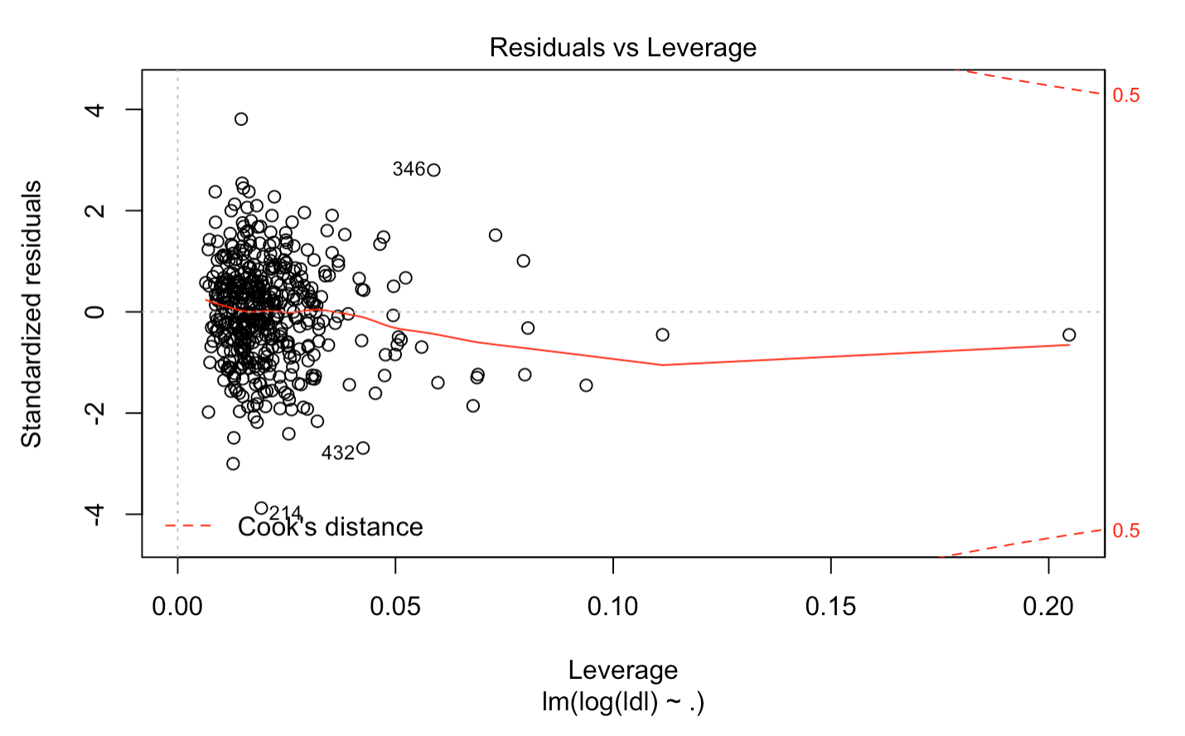
Diagnostic plot in lm() - Residuals vs Leverage plot
The X axis for this plot are the leverage values, higher values of which indicate outliers on X. A high residual (Y axis) suggests an outlier on Y given X.
A “rule of thumb” for Cook’s D is shown by the dotted red lines in the upper and lower right-hand corners of the plot. Values outside this range - that is, beyond either of these dotted red lines - would be considered influential based on the “rule of thumb” and you may want to consider removing such points.

Slide 34
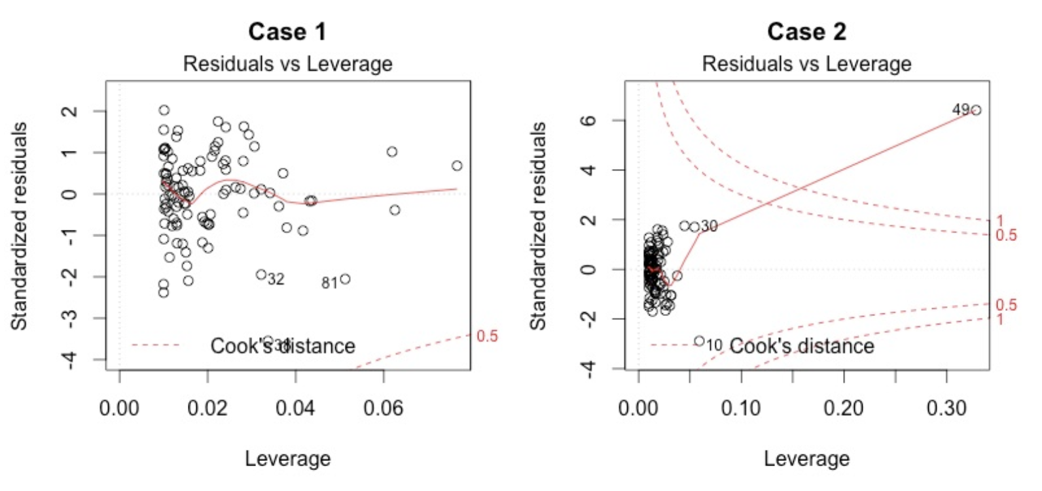
Diagnostic plot in lm() - Residuals vs Leverage plot
The appearance of the residuals vs leverage plot can change considerably based on the residuals and leverage values of the data.
The right plot shows two sets of Cook’s D “rules of thumb” (0.5 and 1.0) because there is a point (49) that is extreme on both axes. This point would almost certainly be a good candidate for omission.
Image credit: https://data.library.virginia.edu/diagnostic-plots/

